Slide 1

Non-Current Liabilities Part 2 – In-Class

Slide 2
Bond Issued Between Dates
Notes:
Talk about (1) and (2) from next slide here

Slide 3
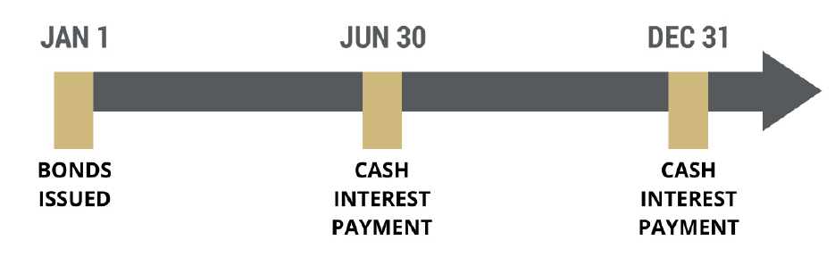
Bond Issuance (so far)

Slide 4
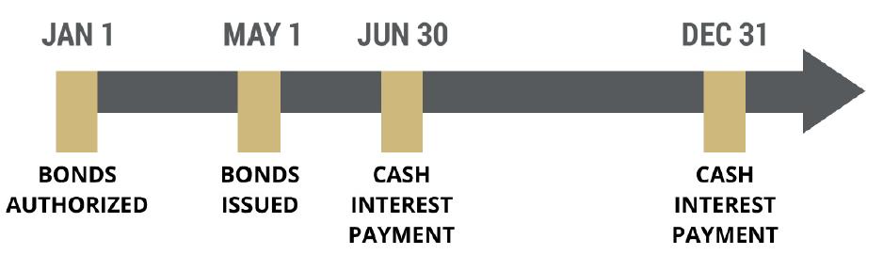
Bond Issuance (now)
How many months have investors owned the bonds on June 30th?
TWO

Slide 5
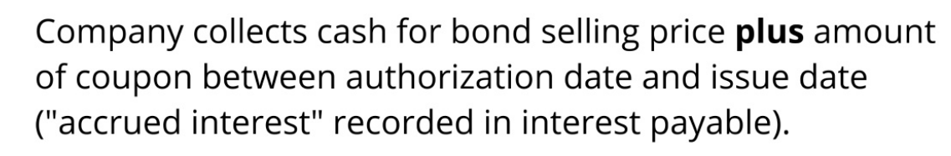
Bond Issuance (now)

Slide 6
Bond Issuance (now)

Slide 7
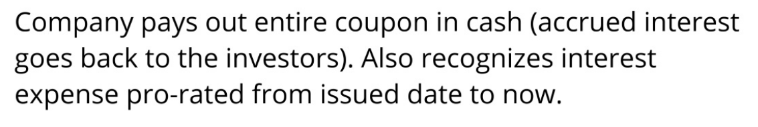
Bond Issuance (now)

Slide 8
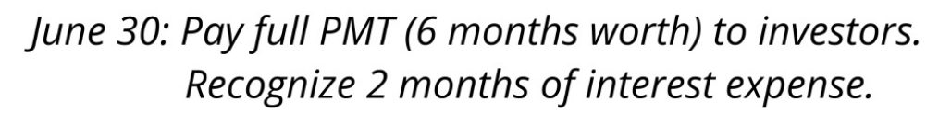
Bond Issuance (now)

Slide 9
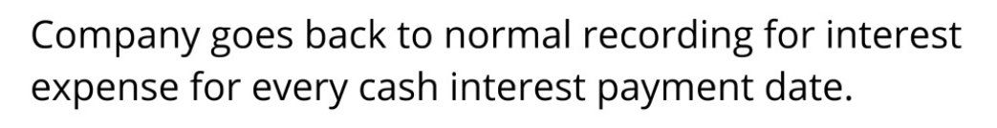
Bond Issuance (now)

Slide 10
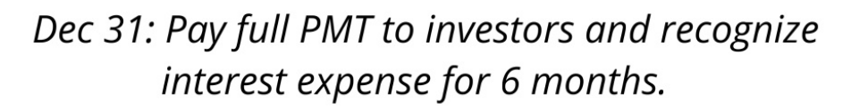
Bond Issuance (now)

Slide 11
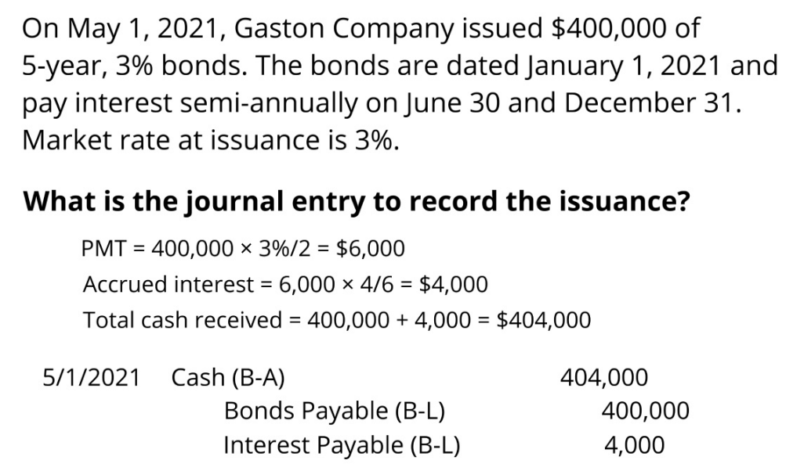
Example

Slide 12
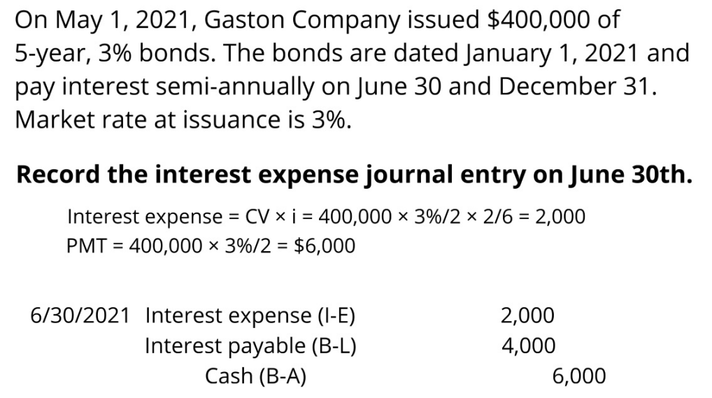

Example

Slide 13
Go to handout…
Prob 1

Slide 14
Retire / Buy Back Bonds
Companies can retire their bonds before maturity in two main ways:
Retire at a call price, if the bond is callable, or
Buy them back on the open market at the current market rate.

Slide 15
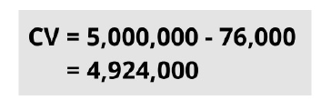
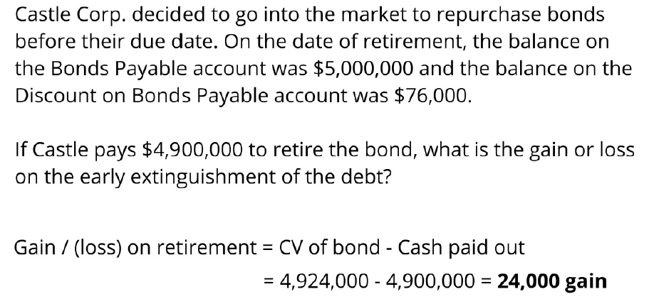
Example

Slide 16
Go to handout…
Prob 2

Slide 17
Financial Instruments
1) Know your basic entries
Note Receivable: Dr NR, Cr Cash (or Equip, Rev) → Possible Disc/Prem
Note Payable: Dr Cash (or Equip), Cr NP → Possible Disc/Prem
Bond Payable: Dr Cash, Cr Bond Pay → Possible Disc/Prem
3) Know your Amortization Table:
Period, Int, Pmt, Amtz, Carry Value

Slide 18
Final Exam Study Tips
Summarize each topic: Simple Summary Notes (Use LLM?)
Work in-Class Problems using only your summary doc
If you need more info to work a problem, add this to the summary doc
Work Practice Exam problems
Complete Comprehensive HW problems (HW#11)
Review past HWs if you want more practice on a topic

Slide 19
FCQs
10 Minutes to Complete Your FCQ
Your feedback is incredibly important for improving this class.
I carefully read your comments and take your input seriously.
Please share what I’m doing well and how this class could be even better.
Your responses also inform my department about the course’s effectiveness. (They look at the number rank)
https://colorado.campuslabs.com/eval-home/

Slide 20
Non-Current Liabilities Part 2 – In-Class

